Slide 1

Multi-Tasking in .NET
Asynchronous vs. Multithreading Programming
Trainer Name: Dhirendra Joshi
26-Sep-2024
© 2024 YASH Technologies | www.yash.com | Confidential

Slide 2
Agenda
01
Processor & Cores
02
CPU vs I/O-Bound Process
03
Program vs Process vs Thread
04
Async vs Concurrency vs Parallelism
05
Foreground vs Background Threads
06
Thread & Thread Pool Class
07
Ways for Multitasking in .NET Framework
08
Live Code
Important!

Slide 3
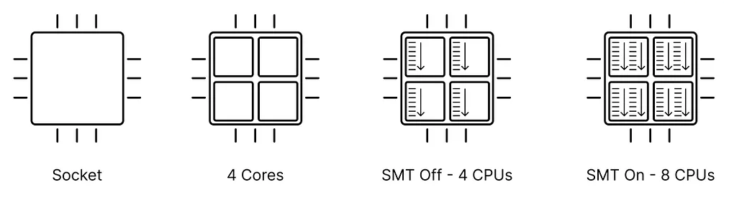
Processor Cores & Multi Threading
A CPU is the primary component of a computer that processes data and instructions to run the operating system and applications.
Core (Heart of Processor) - Process the instructions and data, according to the directions of a software program in the computer's memory.
Physical Core: Real processing unit that's built into a processor.
Logical Core: Logical processing unit that's created by using SMT technology to simulate additional cores.
Total Number Of Logical Processors = Number of CPUs * Number of Cores per CPU * Number of Threads Per Core
Types of Processor
SMT: Simultaneous Multithreading.
Intel’s Proprietary Name: Hyper-Threading Technology (HT Technology)

Slide 4
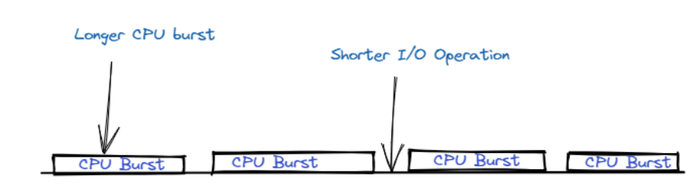
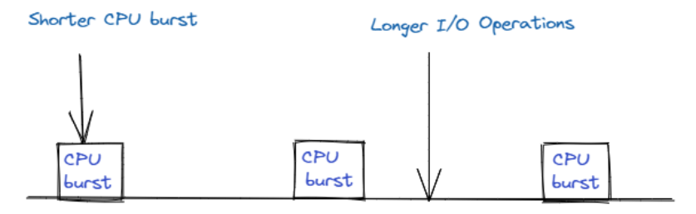
CPU-Bound vs I/O-Bound Process
Important!
Process execution consists of a cycle of CPU execution and I/O wait.
Processes alternate between these two states
CPU Bound Process
Examples:
Graphics rendering
Mathematical calculations
Image or video compression
Cryptographic operations
Data-intensive computations
Image resizing
I/O Bound Process
Examples:
Writing/Reading Files
Copying/Moving Files
Transferring/Downloading Files
Making API requests to External Systems
Notes:
CPU burst is when the process is being executed in the CPU
I/O burst is when the CPU is waiting for I/O for further execution

Slide 5
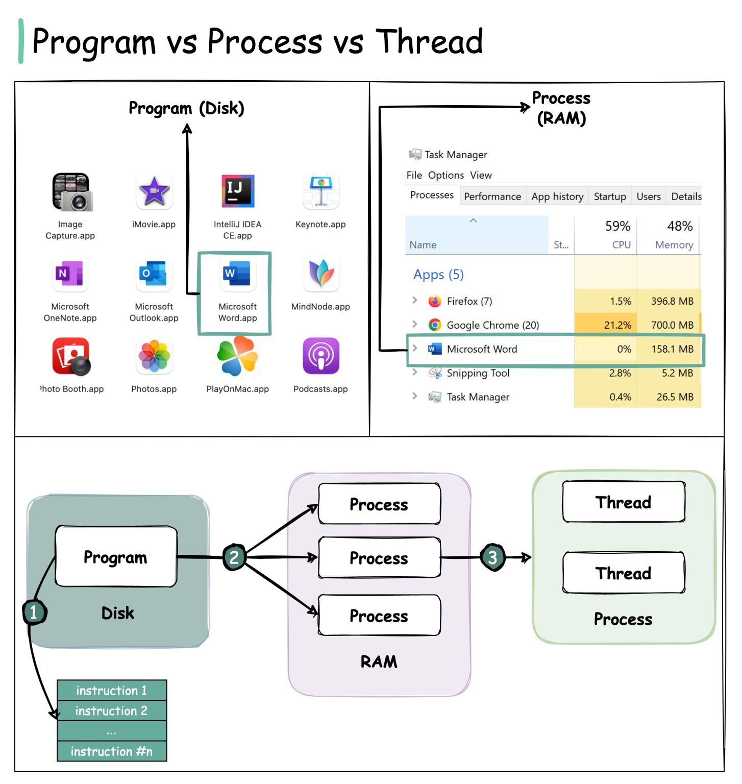
Operating System & Multi Tasking
PROGRAM | PROCESS
List of instructions that gets stored on a hard disk in file. It does not require any other resources. | When a program loads to RAM and starts running, it becomes a process. It holds resources: CPU, Memory, Address, Disk, I/O, etc.
Passive in Nature | Active in Nature
Longer Lifespan | Limited Lifespan
A Thread is the smallest unit of execution within a process.
Threads shares the same Memory Space & Resources within a Process, allowing for more efficient communication and coordination.
Threads enable Parallel Execution of tasks and Multitasking in a single application.
Multi-Programming
Multi-Processing
Multi-Threading

Slide 6

Process Model | Desktop Application
Event/Callback
Program (MyApp)
Process (MyAppProc.exe)
Win Form Application

Slide 7
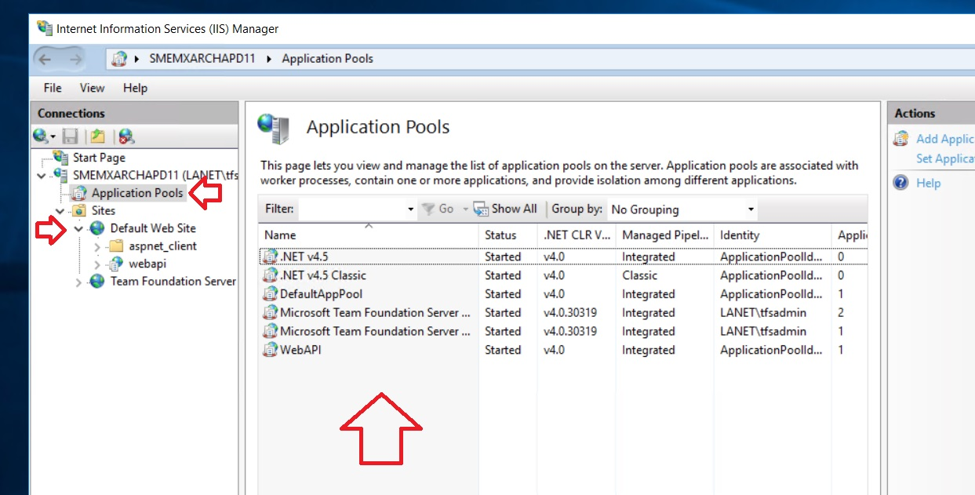
Process Model | Web Application in IIS

Slide 8
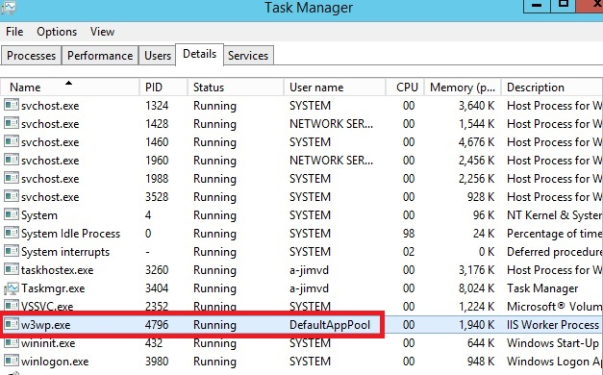
Process Model | Web Application in IIS

Slide 9



Process Model | Web Application in IIS
App Domains
(Logical Isolation)
Configurable Thread Pool:
A managed pool of readily available worker threads that the IIS manages for us.
Request/Response
Program (Application Pools)
DefaultAppPool Worker Process (w3wp.exe)
WebAPIPool
Worker Process
.NET 4.5 Worker Process
.NET App Domain
[ASP.NET Application]
.NET App Domain
[ASP.NET Application]
.NET App Domain
[ASP.NET Application]
.NET App Domain
[ASP.NET Application]

Slide 10

Process Model | Web Application in IIS
Regular Scenario
Request/Response
Program (Application Pools)
DefaultAppPool Worker Process (w3wp.exe)
ASP.NET Application

Slide 11



Asynchronous vs Concurrency vs Parallelism
Asynchronous
Concurrency
Parallelism
Feel of Multi-Tasking
Feel of Multi-Tasking
Actual Multi-Tasking
Single thread on Single Core
Multi-threading on Single Core
Multi-threading on Multiple Core
This enables a program to remain responsive to other events while a long-running task is in progress.
Indicating the interleaving of processes over Time to simulate simultaneous execution.
Each task is allocated a “Time Slice”, and the swift switching between tasks occurs so seamlessly, that it is imperceptible to users.
Denoting the genuine simultaneous execution.

Slide 12
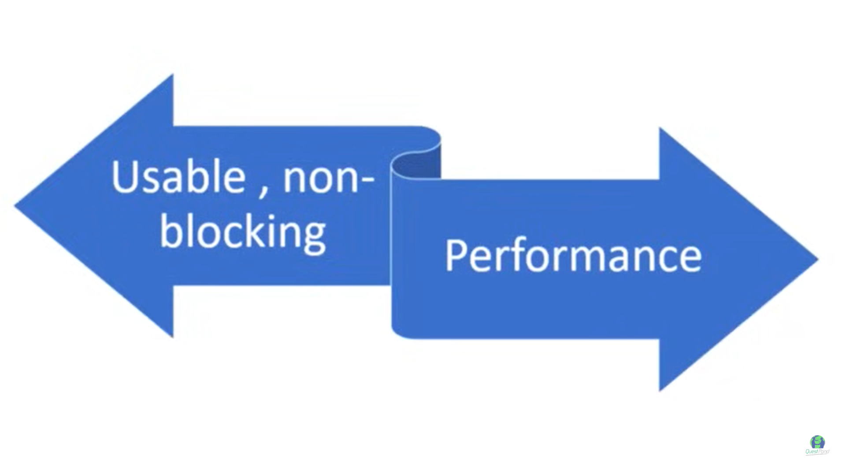
Asynchronous vs Concurrency vs Parallelism
Preferred For
Relatively Costly
Parallelism /
Concurrency
I/O Bound Tasks
CPU Bound Tasks
Asynchronous
Preferred For
Mixing both goals would lead to Over Design or Bad Design

Slide 13
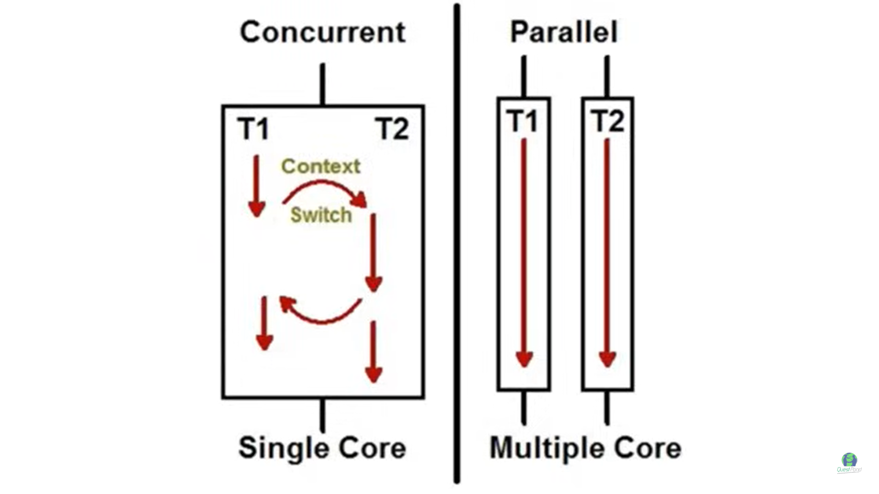
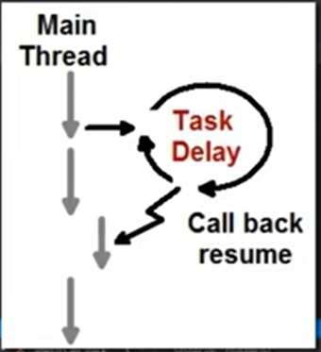
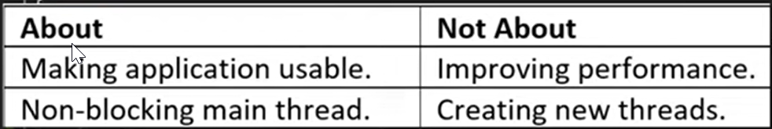
Asynchronous vs Concurrency vs Parallelism
Multi-threading on Single Core
Multi-threading on Multiple Core
Single thread on Single Core
Execution flow is non-deterministic.
But end final output is deterministic.
Asynchronous
Executing multiple tasks on the Same Core using Overlapping OR Time Slicing.
Execution flow & end final output both are non-deterministic.
I/O Bound Tasks
Single Core
Executing multiple tasks on the Multiple Cores at the same time.
Execution flow & end final output both are non-deterministic.
CPU Bound Tasks

Slide 14
Foreground vs Background Threads
Thread is the smallest unit of execution within a process and is a fundamental construct in operating system
Foreground Worker Threads | Background Worker Threads
This is default type of thread in .NET. | Need to explicitly mark a thread as background.
Persistence – Keeps Application active until completion Priority – Higher priority ensures more CPU time compared to other threads Resource Management – Careful management required to ensure they do not consume unnecessary resources | Non-blocking – Allow the application to terminate even if these threads are still running Resource Usage – Generally have lower priority and should be designed to consume minimal resources Automatic Termination – Automatically terminated on application close.

Slide 15
Thread & Thread Pool Class in .NET
System.Threading.Thread
It is the most basic way to run a worker thread in .NET framework.
Directly interacts with OS. Hence, highly configurable – like, Thread Name, Thread Priority, and Thread State.
Creation and destruction of threads incur high resource utilization, mainly CPU overhead.
Description | State
A thread is created | Unstarted
Another thread calls the Thread.Start method on the new thread, and the call returns. During the call to Start, there is no way to know at what point the new thread will start running. The Start method does not return until the new thread has started running. | Running
The thread calls Sleep | WaitSleepJoin
The thread calls Wait on another object. | WaitSleepJoin
The thread calls Join on another thread. | WaitSleepJoin
Another thread calls Interrupt | Running
Another thread calls Suspend | SuspendRequested
The thread responds to a Suspend request. | Suspended
Another thread calls Resume | Running
Another thread calls Abort | AbortRequested
The thread responds to an Abort request. | Stopped
A thread is terminated. | Stopped
The thread state includes AbortRequested, which is now dead, but its state has not yet changed to Stopped. | Aborted
If a thread is a background thread | Background

Slide 16
Thread & Thread Pool Class in .NET
System.Threading.ThreadPool
Wrapper around basic threads and provides a managed pool of worker threads that the .NET manages for us.
This allows developer to concentrate on application tasks rather than thread management.
Reduces the performance penalty by sharing and recycling threads.
Primarily to reuse threads and to ensure the number of active threads is optimal.
Restricts low-level control of threads.
By default, threads created by the Thread Pool are background thread.
Configurable - number of threads can be set to lower and upper bounds.

Slide 17
Thread vs ThreadPool
 | Thread Class | Thread Pool Class
Pros | Offers more flexibility and customization than ThreadPool. Offers more visibility and debugging support than ThreadPool. | Offers better performance, scalability, and resource efficiency than manual thread creation. Handles the life cycle and the recovery of the threads, reducing the risk of errors and leaks.
Cons | Worse performance, scalability, and resource efficiency than ThreadPool. Requires more effort and care from the application to manage the life cycle and the recovery of the threads, increasing the risk of errors and leaks. | Less flexibility and customization than manual thread creation. Less visibility and debugging support than manual thread creation, as it does not expose the details of the threads and the tasks.
Recommended

Slide 18
Ways for Multitasking in .NET Framework
Important!
 |  | Ways for Multi-Tasking | Programming Type | Recommended Operation
Windows OS | Manual Thread (Foreground) | System.Threading.Thread.Start() | Concurrent (Multithread in Single Core) | CPU-bound
.NET Runtime | Thread Pool (Background) | System.Threading.ThreadPool.QueueUserWorkItem() | Concurrent (Multithread in Single Core) | CPU-bound
 |  | System.ComponentModel.BackgroundWorker. RunWorkerAsync() | Concurrent (Multithread in Single Core) | CPU-bound
 |  | Asynchronous Delegate | Asynchronous (Single thread in Single Core) | IO-Bound
 |  | System.Threading.Tasks.Factory.StartNew() System.Threading.Tasks.Run() | Concurrent (Multithread in Single Core) | CPU-bound
 |  | System.Threading.Tasks.Parallel.Invoke() System.Threading.Tasks.Parallel.For() System.Threading.Tasks.Parallel.ForEach() | Parallel (Multithread in Multiple Cores) | CPU-bound
 |  | PLINQ: System.Linq.ParallelEnumerable.AsParallel() | Parallel (Multithread in Multiple Cores) | CPU-bound
 |  | Task-based Asynchronous Pattern (async/await) | Asynchronous (Single thread in Single Core) | IO-Bound

Slide 19
Background vs Foreground Thread
Demonstrate background thread abort with Main thread close, while Foreground threads are not.
Restrict Main thread closure until background thread completion.

Slide 20
System.Threading.Thread.Start()
Demonstrate non-deterministic execution flow with multi-threading.

Slide 21
System.Threading.ThreadPool.QueueUserWorkItem()
Demonstrate countdown.Wait() functionality

Slide 22
System.ComponentModel.BackgroundWorker. RunWorkerAsync()
Demonstrate cancellation of background thread.

Slide 23
Asynchronous Delegate
Asynchronous Delegate is deprecated from .NET Core
Without AsyncCallback
With AsyncCallback
Now Task library is recommended.

Slide 24
Task vs Thread (The Task class was introduced in .NET Framework 4)
Important!
A Thread represents an independent path of execution within a program.
Inherently for Parallel Execution.
It has its own stack and program counter.
A Task is a higher-level abstraction introduced in the Task Parallel Library (TPL) to represent a unit of work.
It is designed to simplify asynchronous programming and parallel processing.
Tasks abstract away the low-level details of thread management
Provide a more developer-friendly approach to concurrent programming.
While Tasks and Threads both represent units of work, they differ in several key aspects:
 | Thread | Task
Level | Lower-level implementation with more fine-grained control | Higher-level implementation
Threading Model | Managed by the operating System | managed by the Runtime environment
Resource Management | require Explicit Resource Management | Managed by the Runtime
Exception Handling | Difficult to handle | Structured approach to exception handling
Result | No direct mechanism to return the result | Can return a result
Application | Long-running or CPU-bound operations | TPL is for both: Short-Running or I/O-bound operations Long-running or CPU-bound operations

Slide 25
System.Threading.Tasks.Factory.StartNew() / System.Threading.Tasks.Run()
Tasks Continuation
Task.ContinueWith()
Task.Factory
ContinueWhenAll()
ContinueWhenAny()
Converging tasks back to the calling thread
Task.Wait: Waits for the Task to complete execution.
Task.WaitAll: Waits for all the provided Task objects to complete execution unless the wait is cancelled.
Task.WaitAny: Waits for any of the provided Task objects to complete execution unless the wait is cancelled.
Task.WhenAll: Creates a task that will complete when all the Task objects in a collection have completed.
Task.WhenAny: Creates a task that will complete when any of the supplied tasks have completed.
TaskCreationOptions -
https://learn.microsoft.com/en-us/dotnet/api/system.threading.tasks.taskcreationoptions?view=net-8.0
Child Tasks example

Slide 26
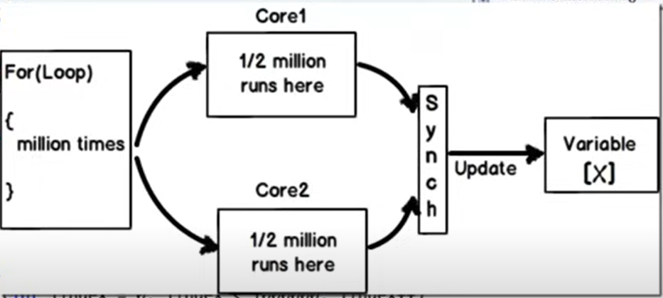
System.Threading.Tasks.Parallel.Invoke() vs ForEach() vs For()
Parallel.Invoke()
Parallel.For()
Parallel.ForEach()
Demonstrate automating spawning of multiple threads on multi-core

Slide 27
PLINQ: System.Linq.ParallelEnumerable.AsParallel()
Demonstrate automating spawning of multiple threads on multi-core

Slide 28
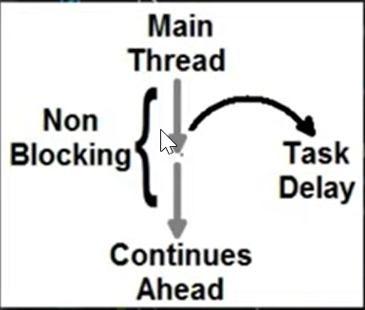
Task-based Asynchronous Pattern (async/await)
Async-Await: They are nothing but code markers which mark code positions from where control should resume after a task (thread) completes.
Clean coding pattern for Asynchronous Programming without much learning curve.
Asynchronous code does NOT use Worker Threads.
Main Thread only executes whole code.
Before Await
After Await
A “lightweight callback worker thread” to update Main thread about await statement completion & move ahead from there.

Slide 29
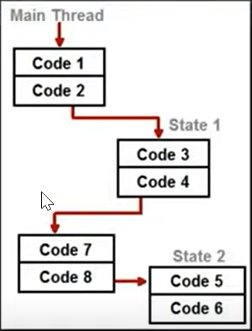
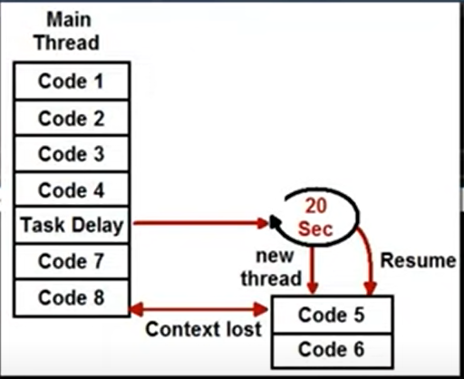
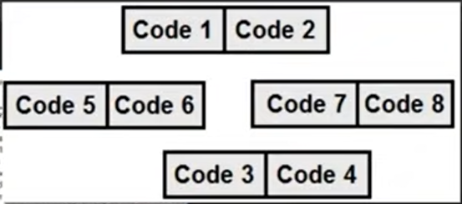
Task-based Asynchronous Pattern (async/await)
Explain concept of “State Machine”.
ConfigureAwait(true): Runs the rest of the code on the same thread the code before the await was run on.
ConfigureAwait(false): Runs the rest of the code on the same thread the awaited code was run on

Slide 30
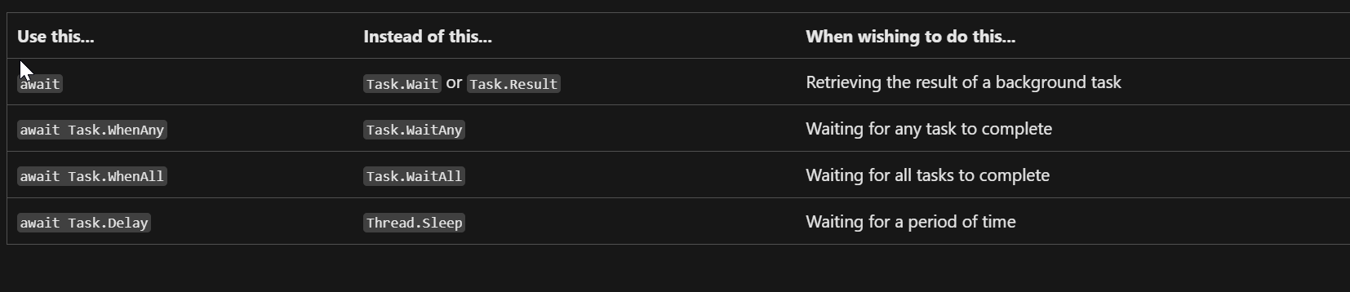
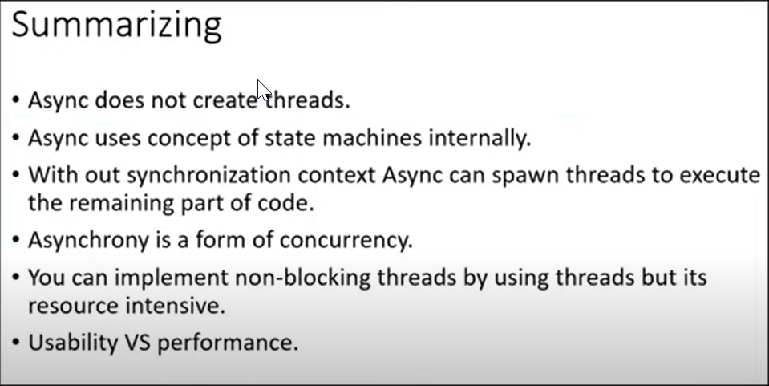
Task-based Asynchronous Pattern (async/await)

Slide 31
THANK YOU

